Slide 1
breast
Dr Tampaki Ekaterini Christina, Plastic and Reconstructive Surgeon
OPBC –Oncoplastic Breast Consortium
https://www.oncoplasticbc.org/
Dr Filippou Dimitrios, Assistant Professor- General Surgeon
Dr Sinou Natalia, PhD candidate

Slide 2
The breast is located on the upper ventral region of the torso of primates. In females, it serves as the mammary gland, which produces and secretes milk and feeds the infants.

Slide 3
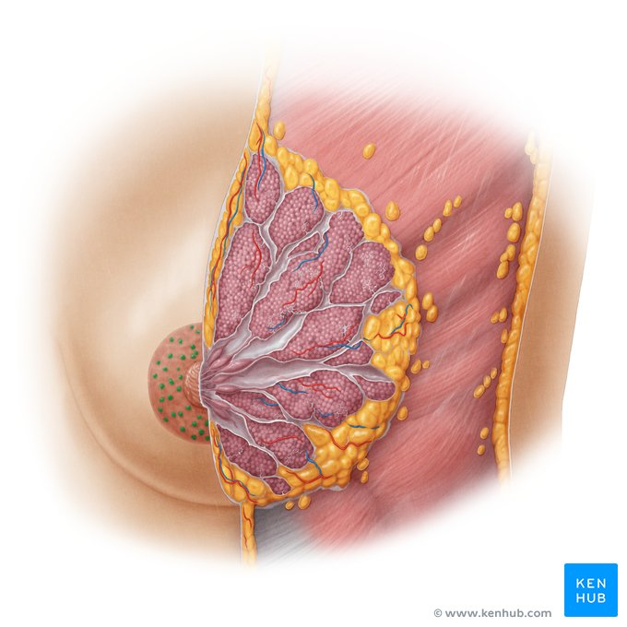
Breast Anatomy
Female breast structure:
Base of chest: Midline of chest -- midaxillary line
2nd-6th ribs
Nipple – 4ICS
Overlies the pectoralis major muscle and part of the serratus anterior muscle, the rectus sheath and the external obligue muscles.

Slide 4
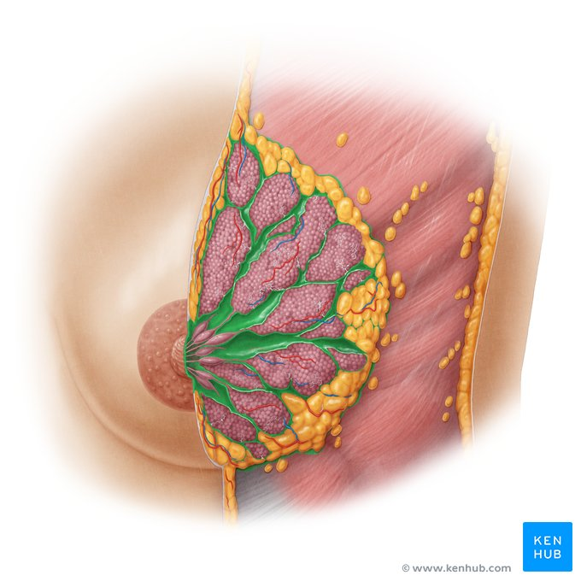
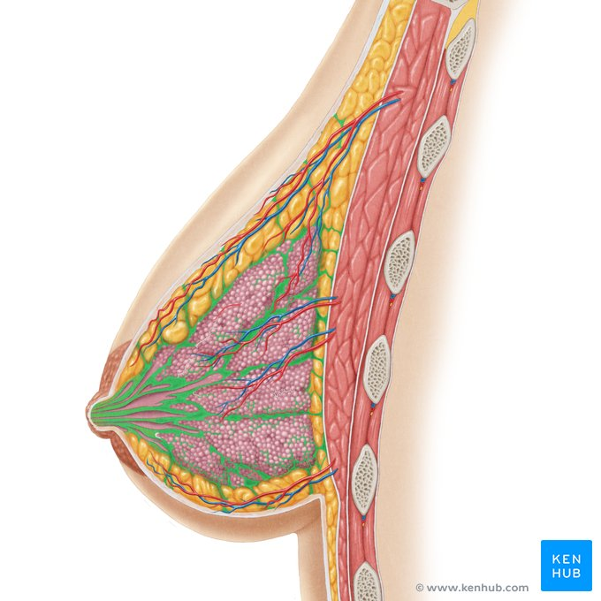
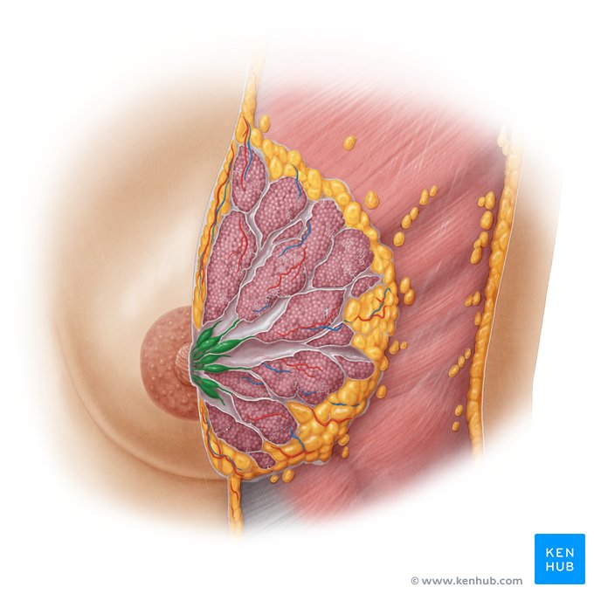
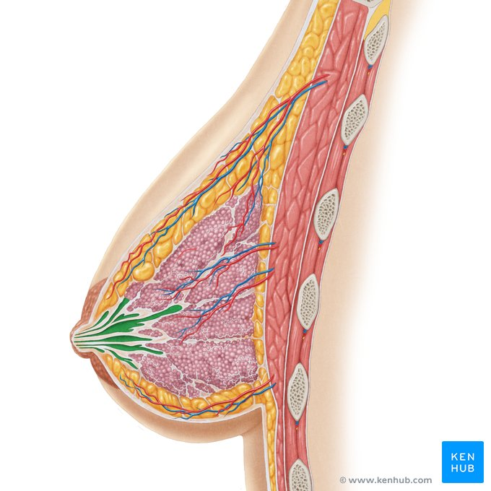
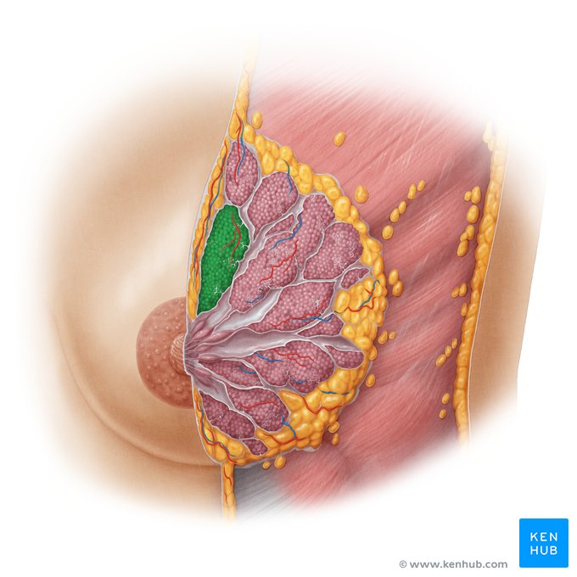
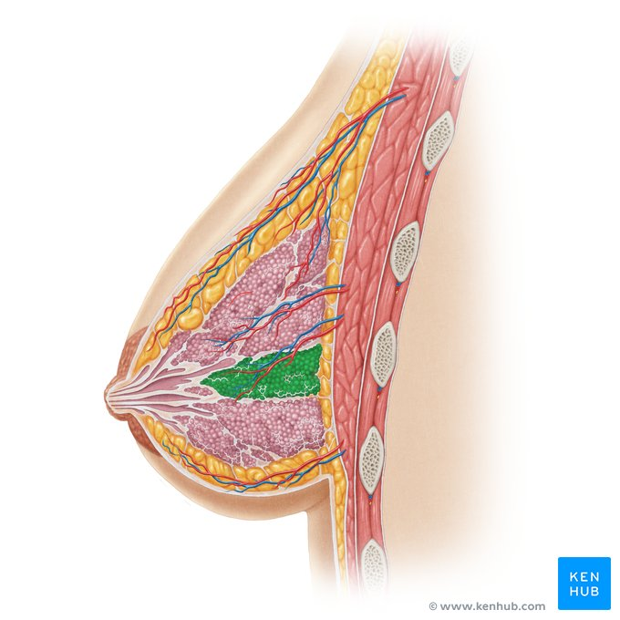
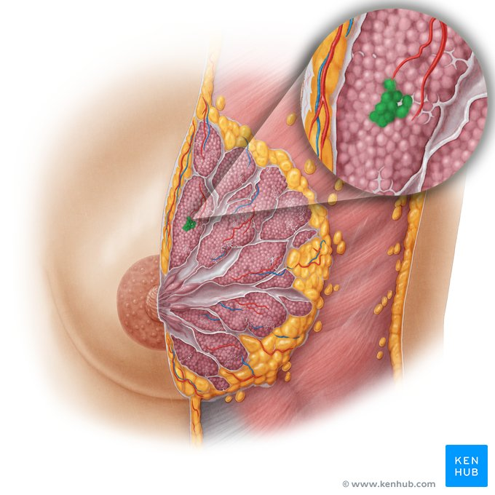
The human breast is made up of milk-producing glands the mammary glands.
A mammary gland consists of 15-20 secretory lobes divided by the suspensory ligaments or Cooper's ligaments (fibrocollagenous septa – connective tissue).
Breast tissue is supported and attached to the chest wall by the Cooper’s ligaments: Fibrous bands that originate from the underlying pectoral fascia and insert to the dermis of the overlying skin, supporting the non-ptotic shape of the breasts – similar to an internal bra
Fat covers the lobes and shapes the breast
Lobules fill each lobe. Sacs at the end of lobules produce milk
The lobes converge towards the lactiferous ducts which convey the milk out of the breast through the nipple

Slide 5
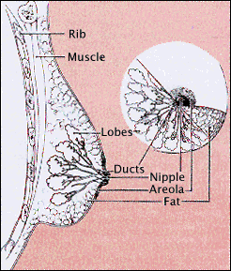

Slide 6
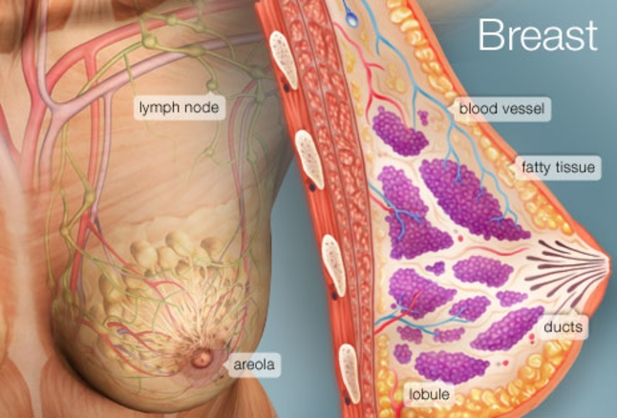

Slide 7
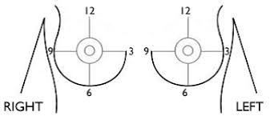
Breast Clock and Quadrants

Slide 8
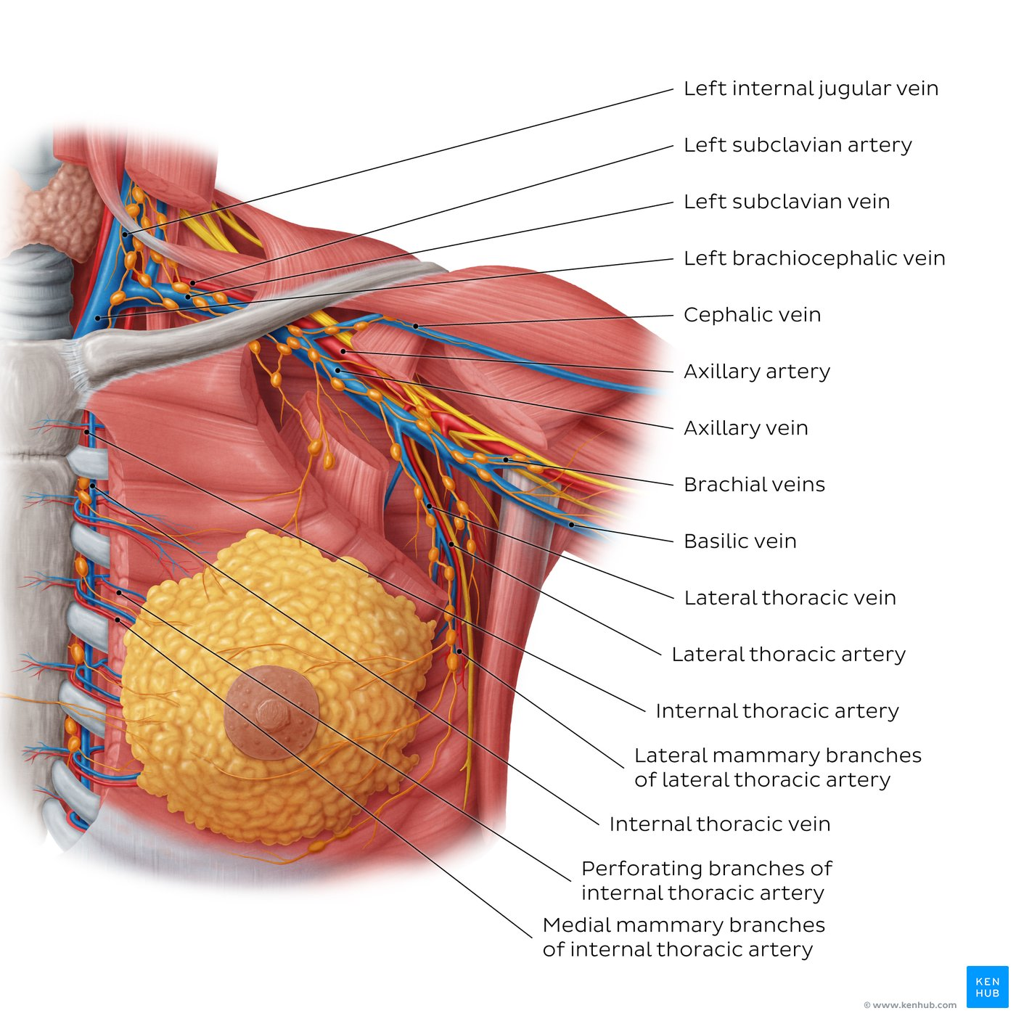
Blood Supply
Arterial Supply:
Internal thoracic artery: Medial mammary branches and anterior intercostal branches (medial aspect of the breast)
Axillary artery: Lateral thoracic artery, pectoral branch of thoracoacromial artery (superolateral aspect of the breast)
Posterior intercostal artery (lateral part of the breast)
Venous Drainage:
Axillary vein: Receives blood from cephalic, basilic, brachial and lateral thoracic veins
Posterior intercostal vein: Drain the lateral aspect of the breast into the azygos system
Internal thoracic vein: Drains the medial aspect of the breast into the brachiocephalic vein.

Slide 9
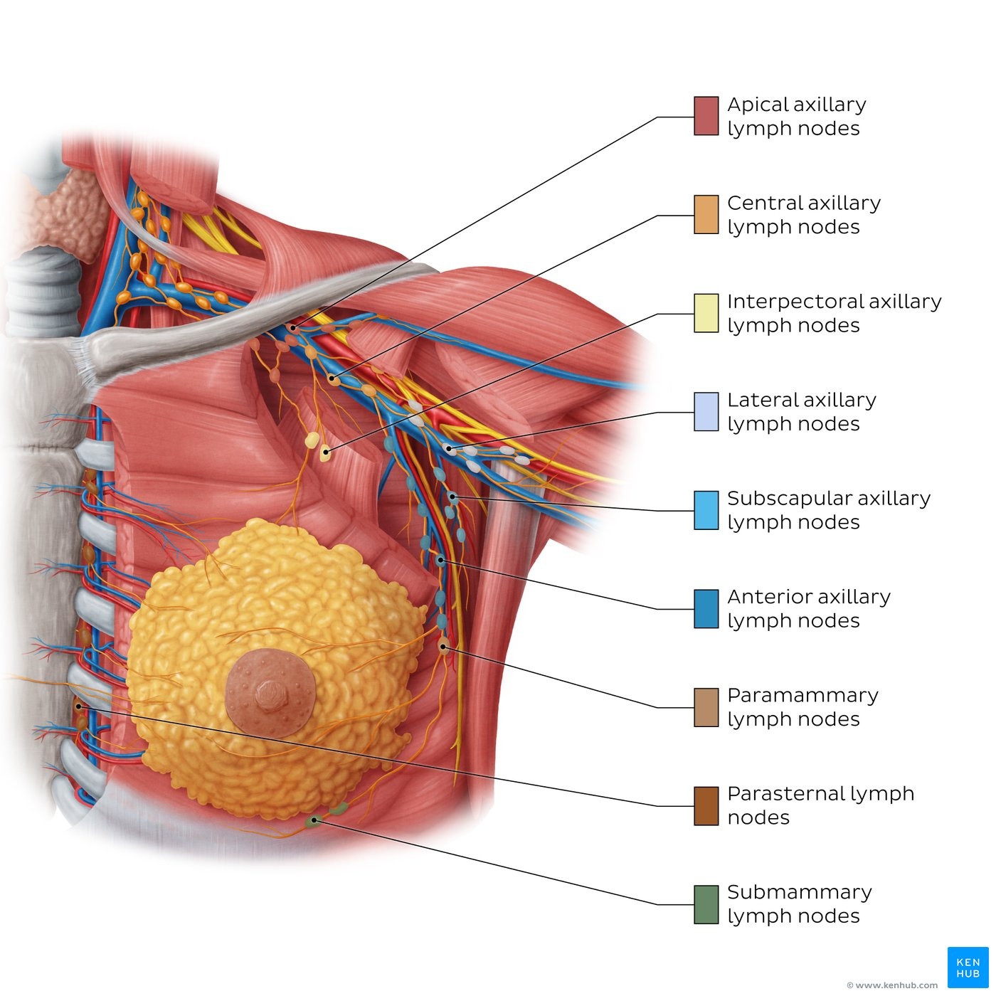
Regional Breast Lymph Nodes
Axillary lymph nodes
Located in the underarm to the collarbone
Include interpectoral or Rotter nodes
They receive a 75-90% of the breasts' lymph, which passes through a sentinel lymph node situated at the lateral border of pectoralis major.
Internal mammary (parasternal) lymph nodes
Tucked under the sternum
They receive a 10-25% of the breast's lymph
Infraclavicular (subclavicular) lymph nodes
In the deltopectoral groove
Supraclavicular lymph nodes
Above the collarbone

Slide 10
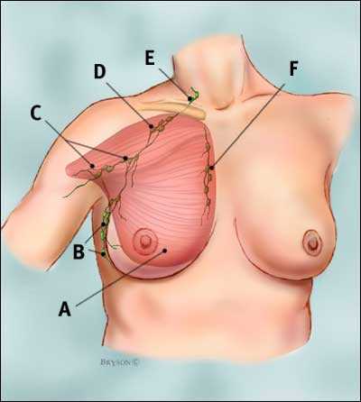
Breast - Regional Lymph Nodes
A: Pectoralis major muscle
B: Axillary lymph nodes level I
C: Axillary lymph nodes level II
D: Axillary lymph nodes level III
E: Supraclavicular lymph nodes
F: Internal mammary lymph nodes

Slide 11
Main Breast Function
The breast produces milk which serves infant nutrition. Breast milk contains carbohydrate (lactose), fats and proteins as well as micronutrients and offers immunological protection to the newborn baby.
Milk production in the mammary gland is regulated by prolactin, while milk ejection through the nipple is regulated by oxytocin.

Slide 12
At puberty
As a girl approaches her teen years, the first visible signs of breast development begin. When the ovaries start to produce and release (secrete) estrogen, fat in the connective tissue starts to collect. This causes the breasts to enlarge
The duct system also starts to grow. Often these breast changes happen at the same that pubic hair and armpit hair appear

Slide 13
At menstrual cycle
Each month, women go through changes in the hormones that make up the normal menstrual cycle. The hormone estrogen is produced by the ovaries in the first half of the menstrual cycle.
It stimulates the growth of milk ducts in the breasts. The increasing level of estrogen leads to ovulation halfway through the cycle. Next, the hormone progesterone takes over in the second half of the cycle.
It stimulates the formation of the milk glands. These hormones are believed to be responsible for the cyclical changes that many women feel in their breasts just before menstruation. These include swelling, pain, and soreness

Slide 14
During pregnancy and milk production
Breast changes are one of the earliest signs of pregnancy. This is a result of the hormone progesterone. In addition, the dark areas of skin around the nipples (the areolas) begin to swell. This is followed by the rapid swelling of the breasts themselves.
By the fifth or sixth month of pregnancy, the breasts are fully capable of producing milk. As in puberty, estrogen controls the growth of the ducts, and progesterone controls the growth of the glandular buds.
Many other hormones also play vital roles in milk production. These include (FSH), (LH), prolactin, oxytocin, and human placental lactogen (HPL).
Blood vessels in the breast becoming more visible and the areola getting larger and darker. All of these changes are in preparation for breastfeeding the baby after birth

Slide 15
What happens to the breasts at menopause?
By the time a woman reaches her late 40s and early 50s, perimenopause is starting or is well underway.
At this time : the levels of estrogen and progesterone begin to change.
Estrogen levels dramatically decrease. This leads to many of the symptoms commonly linked to menopause.
Without estrogen, the breast’s connective tissue becomes dehydrated and is no longer elastic.
The breast tissue, which was prepared to make milk, shrinks and loses shape.

Slide 16
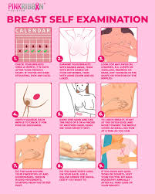
Breast health
To promote breast health, consider doing regular breast self-exams.
Concerns about breast lumps, breast pain or nipple discharge
Common screening and diagnostic tests for breast health, such as clinical breast exams, mammograms and breast ultrasounds

Slide 17
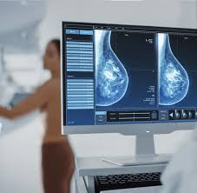
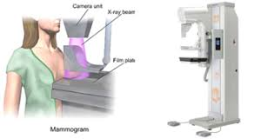

Slide 18
Methods of the clinical breast examination
Inspect ( relaxed, arms raised, hand on hips)
Breast symmetry
skin changes (edema, ulceration)
nipples (retraction, discharge)

Slide 19
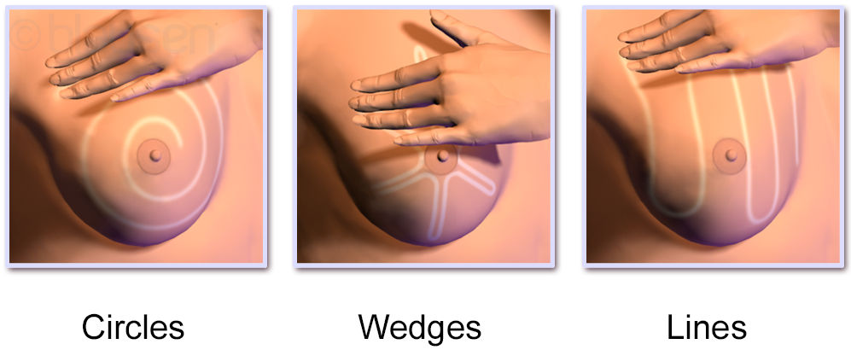
Breast – Self-exam
ask the patient to lie flat and stand at the patient's right side
place a small pillow under the shoulder with ipsilateral arm above head
warm your hands and keep conversing with patient to make them comfortable
palpate breasts with both the flat of your hand and fingers.
with flat fingers compress breast tissue
follow systematically, in a circular pattern around the nipple or along the radial lines (simulate a clock) or vertical segments and feel the entire breast, including the tail near the axilla.
consistency of tissue
fat (soft) and gland (lumpy)
firm transverse ridge along lower edge

Slide 20
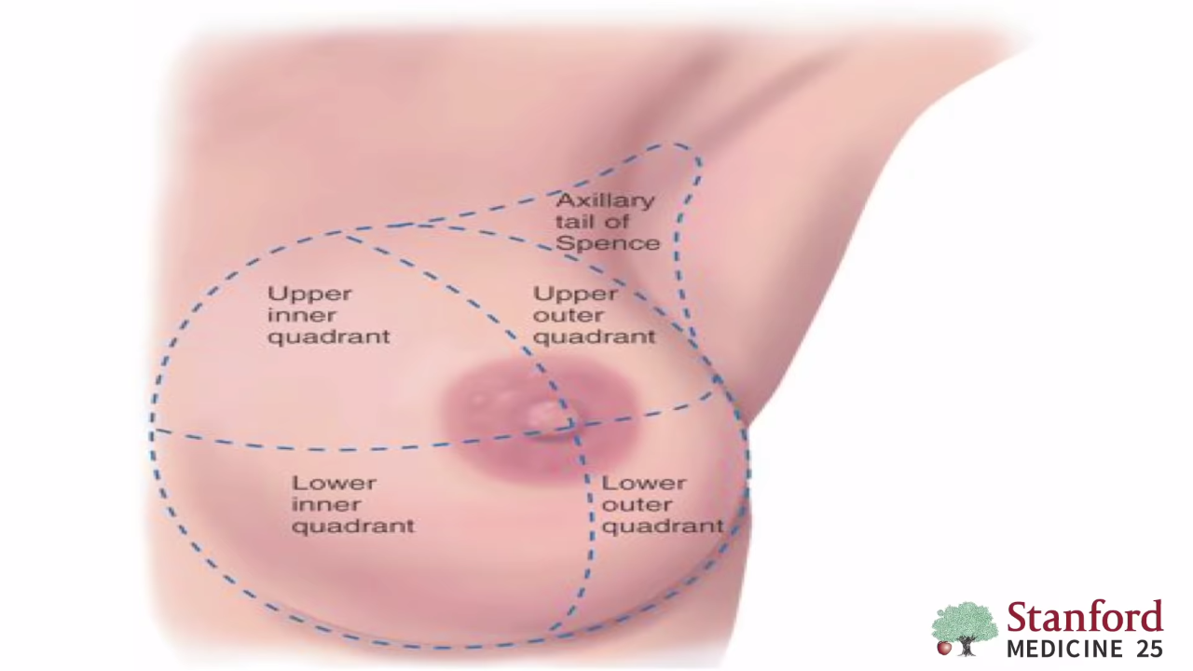
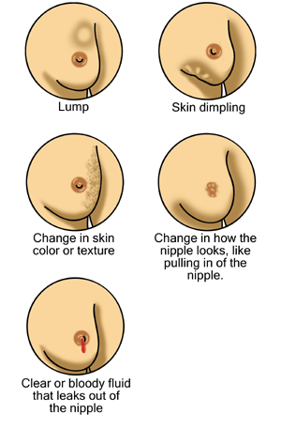
- note any tenderness
- feel the areola and nipple. Compress the areola, going about its circumference.
- Gently squeeze the nipple to note for discharge. Palpate nipple for elasticity
Focused examination
Characteristics of mass if any / Dominant mass
location
size
shape
consistency
delimitation
mobility
move mass and watch for dimpling
tenderness

Slide 21
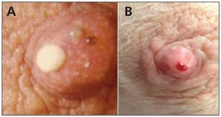
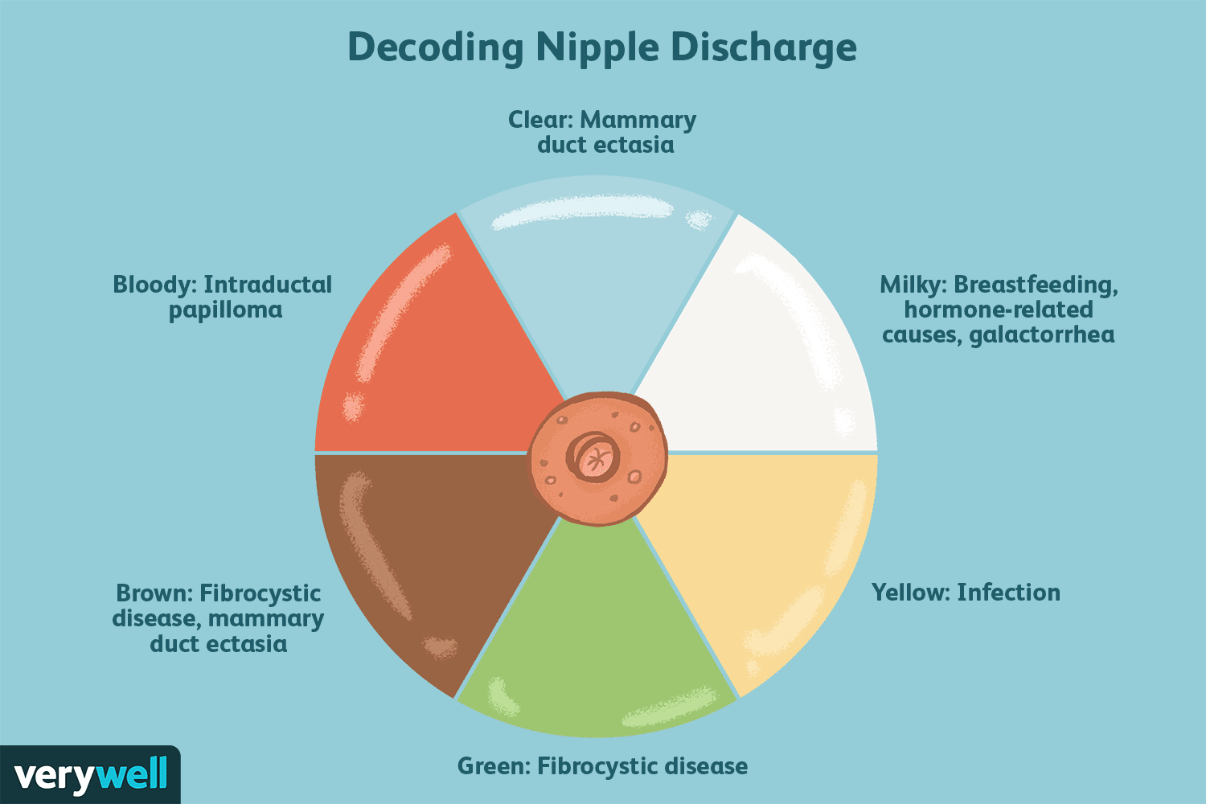
Spontaneous discharge
compress the areola with index finger in radial positions around nipple
note color, consistency and quantity of discharge
Normal:
Breast has firm elasticity in young. Glandular tissue may feel lobulated, granular, irregular ("tapioca").
Slight tenderness and fullness can be anticipated in premenstrual period.
In older women, breasts feel stringy

Slide 22
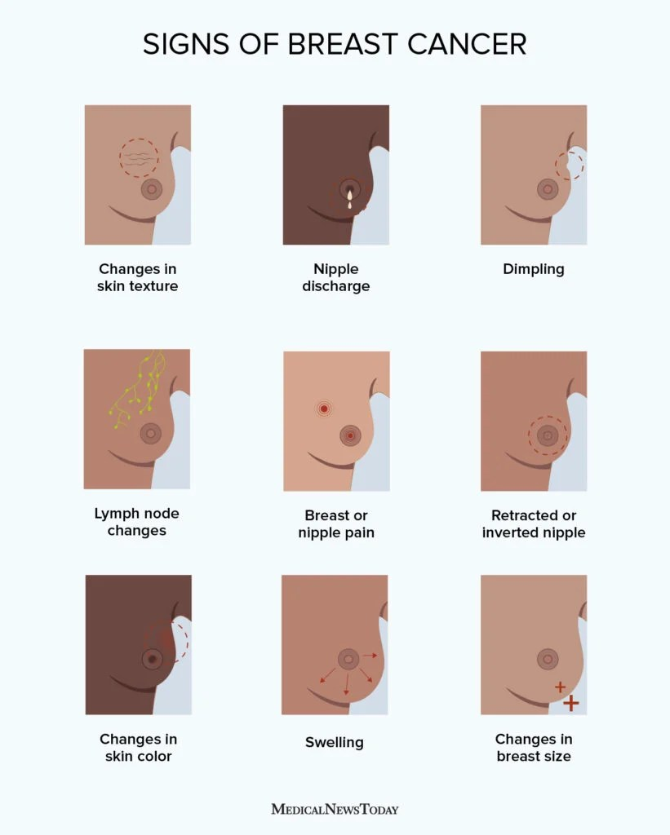
Abnormal changes of the breast
1- A firm lump, never felt before.
2- Swelling around the breast, collarbone, or armpit.
3- Dry, cracked, red, or thickened skin (like an orange peel) around nipple.
4- Blood or fluid (besides milk) leaking from nipples.
5- Warmth or itching in breasts.

Slide 23
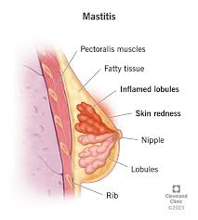
Mastitis

Slide 24
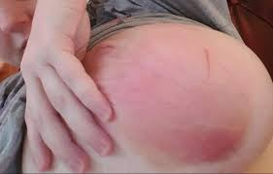
Mastitis Symptoms
An infection in the tissue of one or both of the mammary glands inside the breasts. It usually affects women who are producing milk and breast-feeding.
There is often a hard, sore spot inside the breast. This can result from a blocked milk duct or because bacteria enter the breast through a break in the skin.
Sometimes, it can affect women who are not lactating, but it is uncommon. In very rare cases, it can affect men.

Slide 25
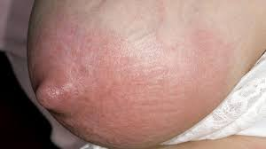
Mastitis Symptoms
An area of the breast becoming red and swollen
The affected area of the breast hurting when touched
The affected area feeling hot when touched
A burning sensation in the breast that may always be there or only when breast-feeding
Flu-like symptoms

Slide 26
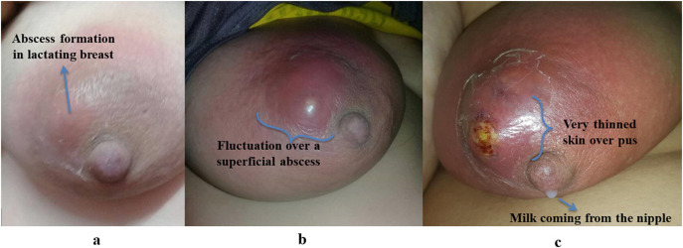
The following mastitis symptoms may also be present:
anxiety and feeling stressed
chills and shivering
elevated body temperature
fatigue
general aches and pains
a feeling of malaise

Slide 27
Management and Treatment
Hydration
Getting plenty of rest.
Generally, continue breastfeeding the baby, making sure that he or she is correctly attached to the breast.
Taking counter pain relievers such as ibuprofen to help reduce fever or pain. If needed antibiotics

Slide 28
Breast Cancer
Breast cancer is the most common invasive cancer in women and the second leading cause of cancer death in women after lung cancer.
Advances in screening and treatment for breast cancer have improved survival rates dramatically since 1989. According to the American Cancer Society (ACS), there are more than 3.1 million breast cancer survivors in the United States. The chance of any woman dying from breast cancer is around 1 in 38 (2.6%).
Cancers developing from the ducts are ductal carcinomas.
Cancers developing from the lobules are lobular carcinomas

Slide 29
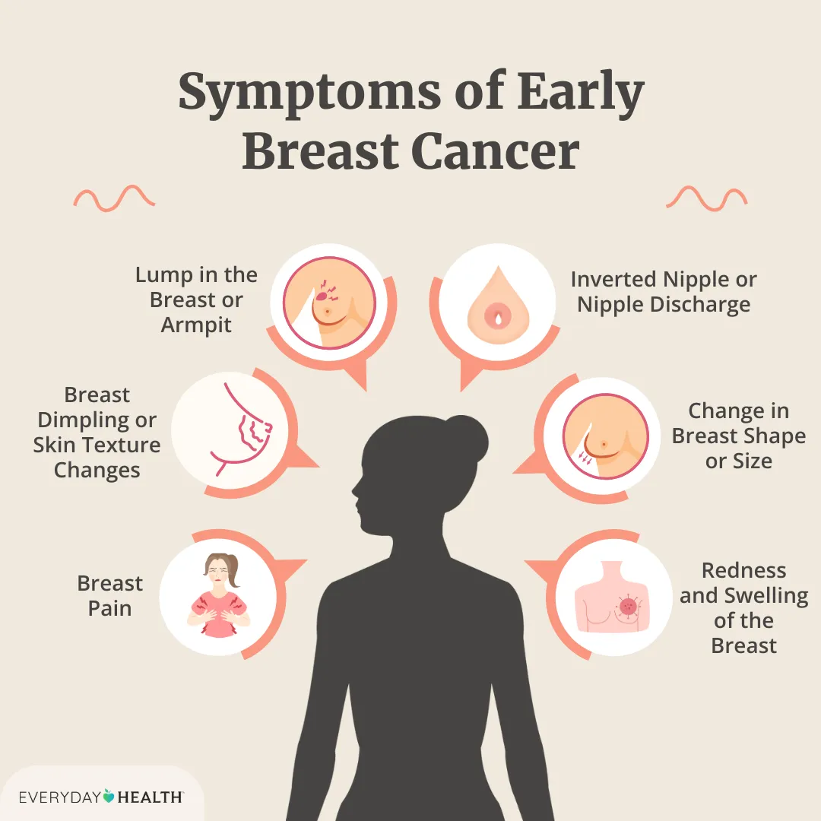
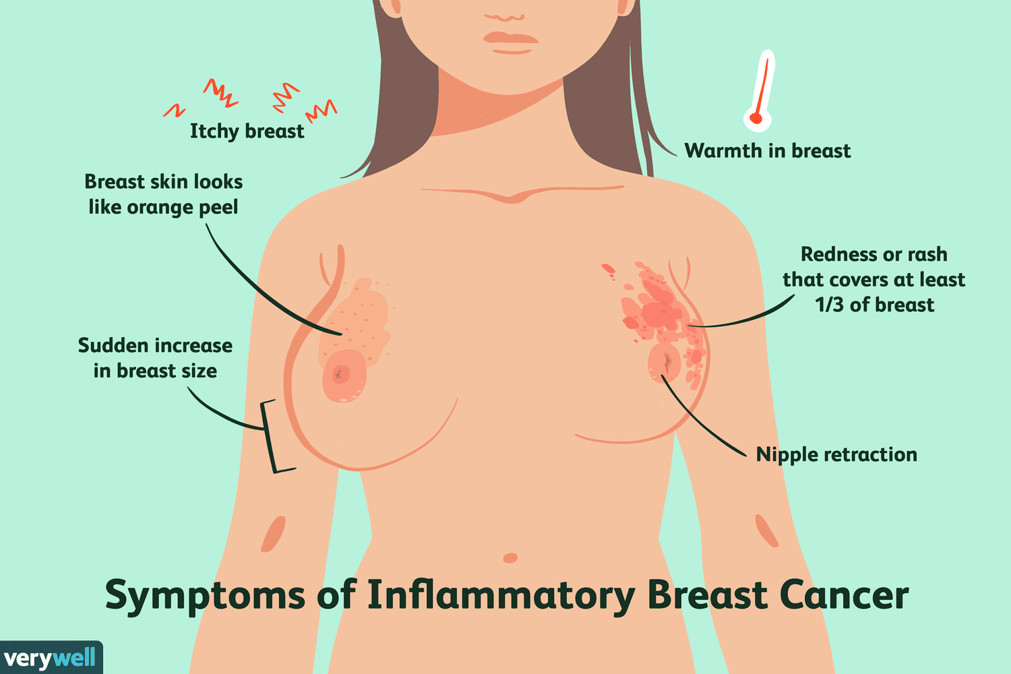
Symptoms
The first symptoms of breast cancer usually appear as an area of thickened tissue in the breast or a lump (differentiation with fibrocystic breast disease) in the breast or an armpit.
pain in the armpits or breast that does not change with the monthly cycle
pitting or redness on the skin of the breast, similar to the surface of an orange
a rash around or on one of the nipples
discharge from a nipple, possibly containing blood
a sunken or inverted nipple
a change in the size or shape of the breast
flaking, or scaling of the skin on the breast or nipple

Slide 30
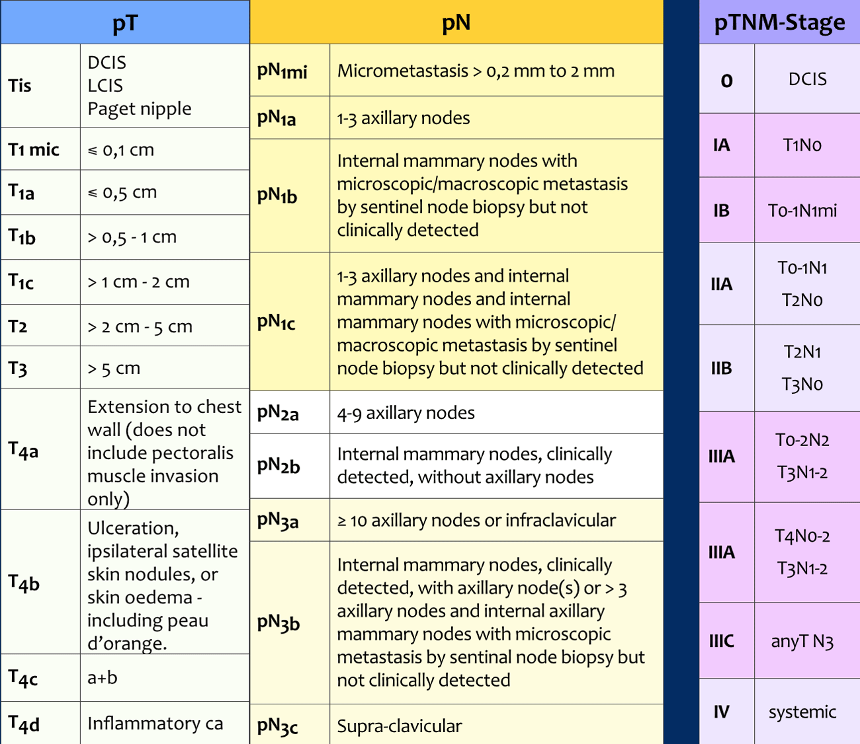
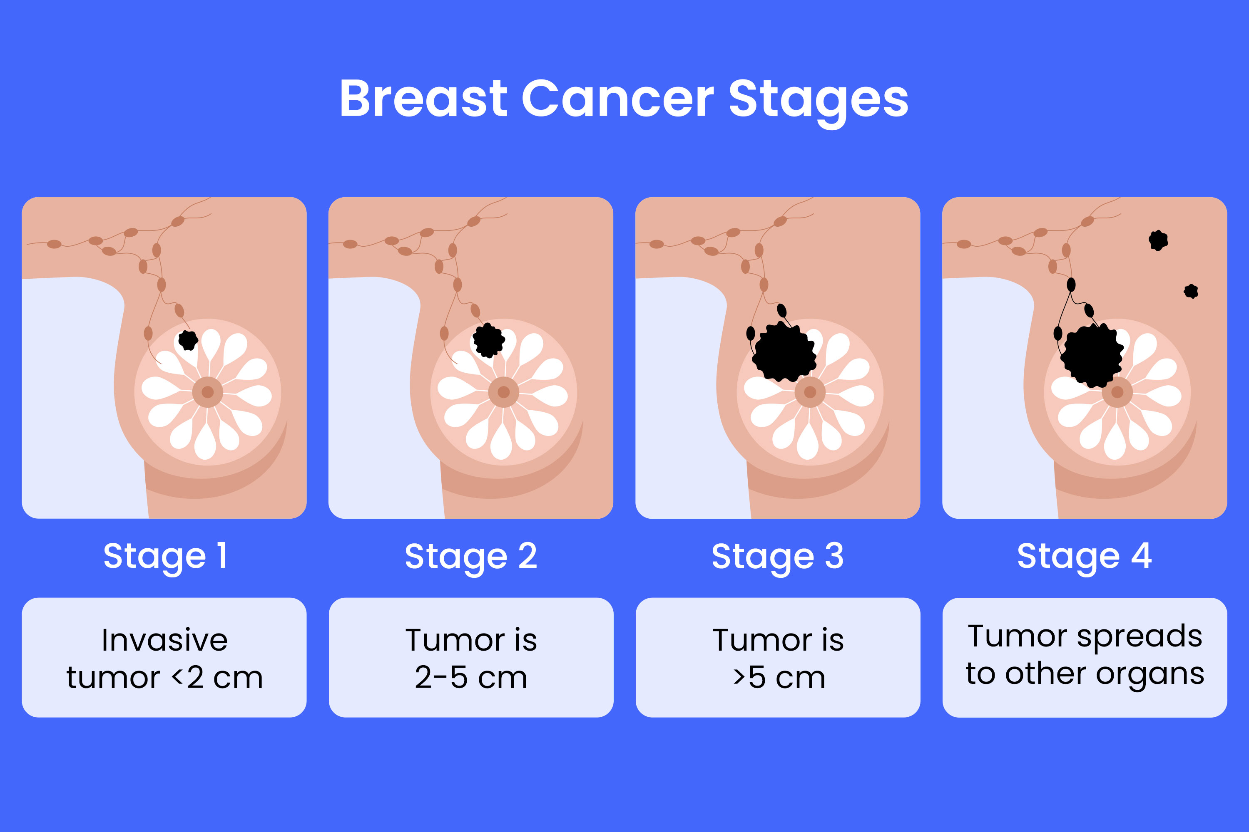
Stages

Slide 31
Risk factors for breast cancer
Age: The chances of breast cancer increase as one gets older.
Family history: The risk of breast cancer is higher among women who have relatives with the disease. Having a close relative with the disease (sister, mother, daughter) doubles a woman's risk.
Personal history: Having a breast cancer diagnosis in one breast increases the risk of cancer in the other breast
Women diagnosed with certain benign (non-cancerous) breast conditions have an increased risk of breast cancer.
Menstruation: Women who started their menstrual cycle at a younger age (before 12) or went through menopause later (after 55) have a slightly increased risk.
Breast tissue: Women with dense breast tissue (as documented by mammogram) have a higher risk of breast cancer.

Slide 32
Risk factors for breast cancer
Race: White women have a higher risk of developing breast cancer
Exposure to previous chest radiation
Having no children or the first child after age 30
Being overweight or obese
Use of oral contraceptives in the last 10 years
Using combined hormone therapy after menopause increases the risk of breast cancer.
Alcohol consumption
Genetic risk factors (BRACA1, BRACA2 most common)

Slide 33
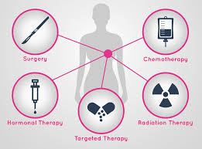
Treatment
Surgery: SLN Biopsy, axilla LN dissection, mastectomy, breast conserving approaches, breast reconstruction.
radiotherapy.
chemotherapy.
hormone therapy.
biological therapy (targeted therapy)

Slide 34
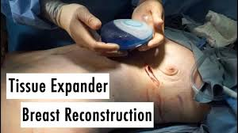
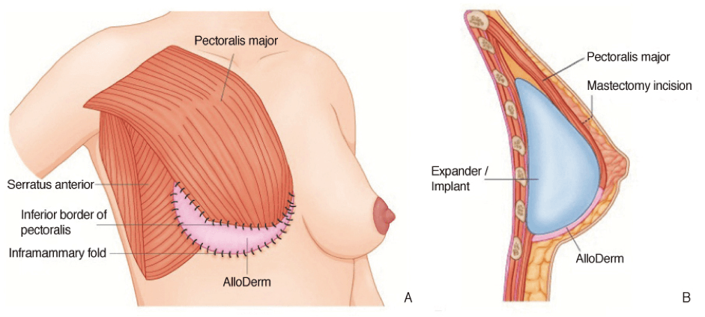
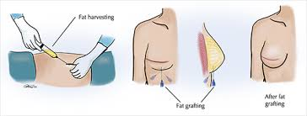
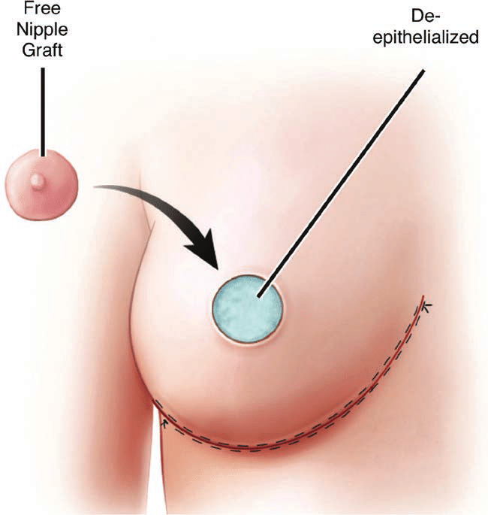
Breast Reconstruction

Slide 35
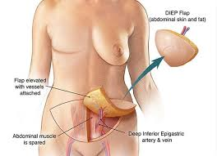
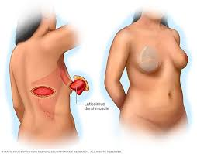
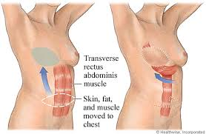
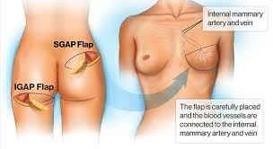
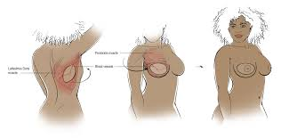
Breast Reconstruction – Flap Surgery

Slide 36
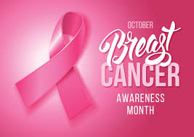
Thank you Questions?

